Slide 1
Jupyter Notebook
[web] portal.biohpc.swmed.edu [email] biohpc-help@utsouthwestern.edu
2021-05-19

Slide 2
Outline
Overview
Getting started
Using Jupyter and basic functionality
Considerations and recommendations

Slide 3
Overview
Interactive session that can include
Formatted text
Executable code snippets
Equations (LaTeX syntax)
Updatable graphs and images
Can improve reproducibility and portability of documents and results
Example use-cases
Documented workflows and pipelines
Course material

Slide 4
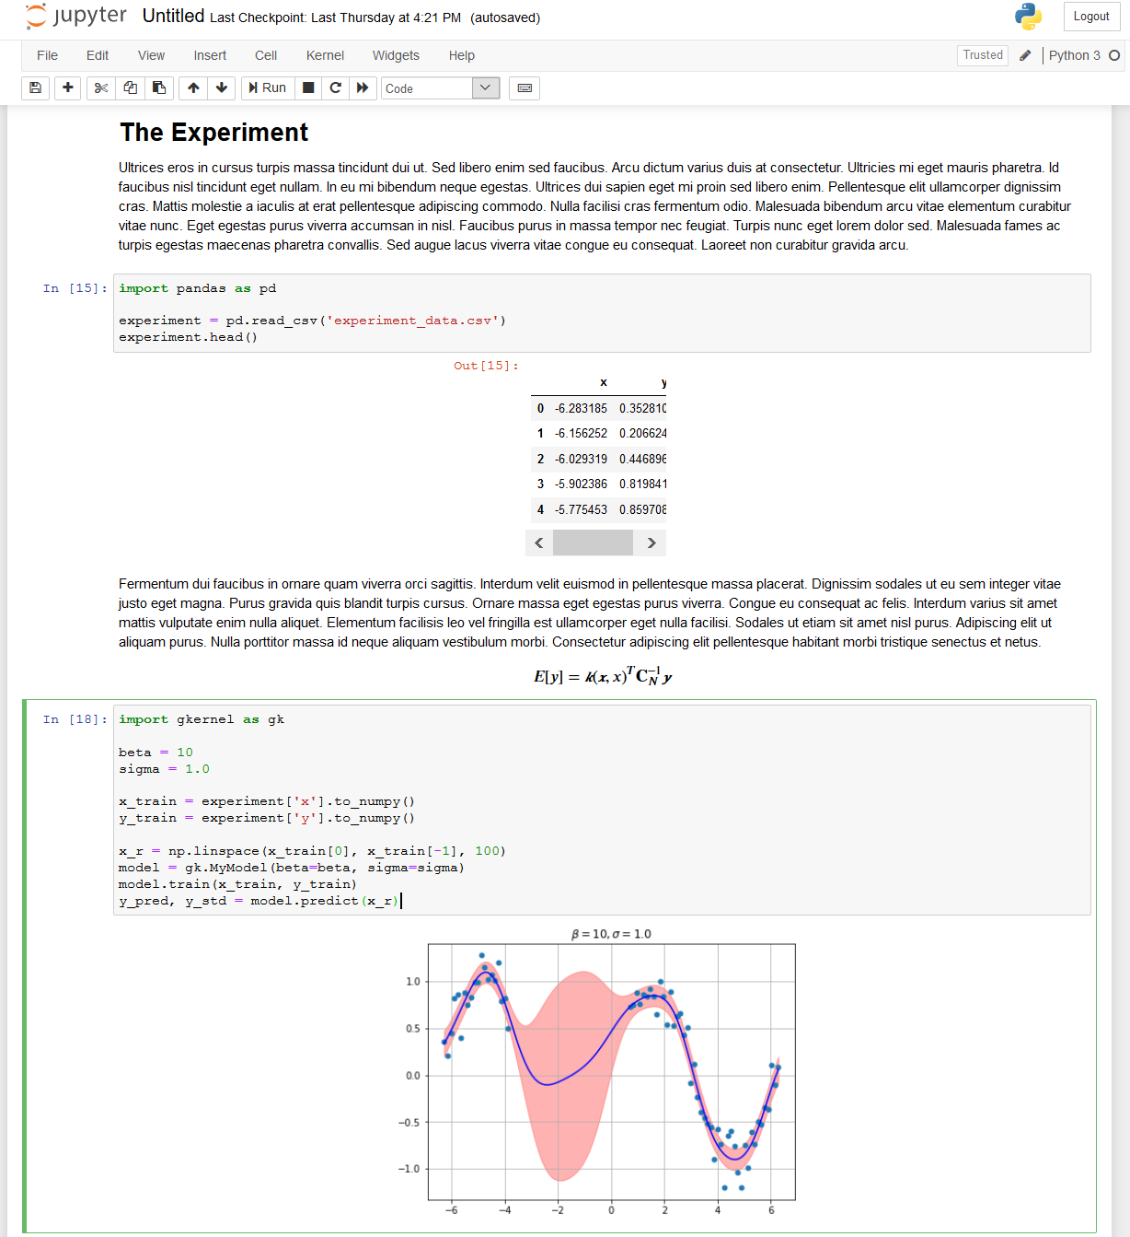
Example
Load and reference data
Formatted text along with equations
Executable code snippets

Slide 5
Comparison
MS Word Document
Jupyter Notebook
Single binary file (.docx, .doc)
MS Word application to open and edit
WYSIWYG editor
Editable (text), uninterpreted, static content (generally)
Single main file, text formatted (.ipynb)
and additional optional assets
Browser displays text file via a web server (needs python runtime env)
Simple markup (md) text
Editable, interactive, executable content for in-place (re-)creation.

Slide 6
Getting Started
BioHPC
Local

Slide 7
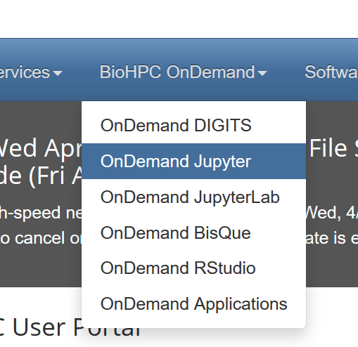
Getting Started - BioHPC
Portal https://portal.biohpc.swmed.edu/terminal/ondemand_jupyter/

Slide 8
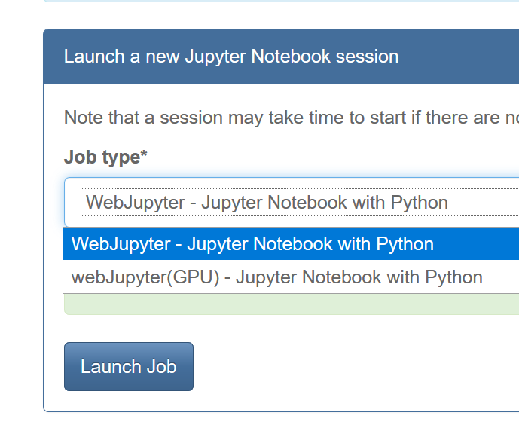
Getting Started - BioHPC
Portal https://portal.biohpc.swmed.edu/terminal/ondemand_jupyter/

Slide 9
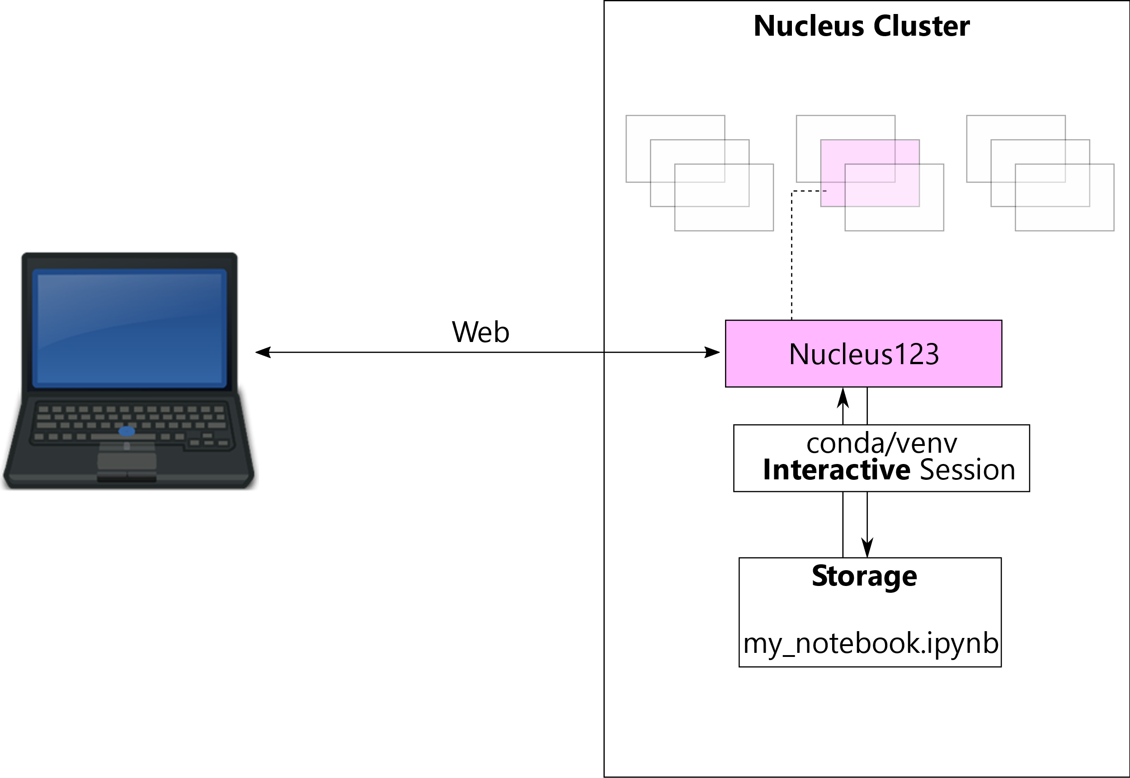
Mental Model - BioHPC

Slide 10
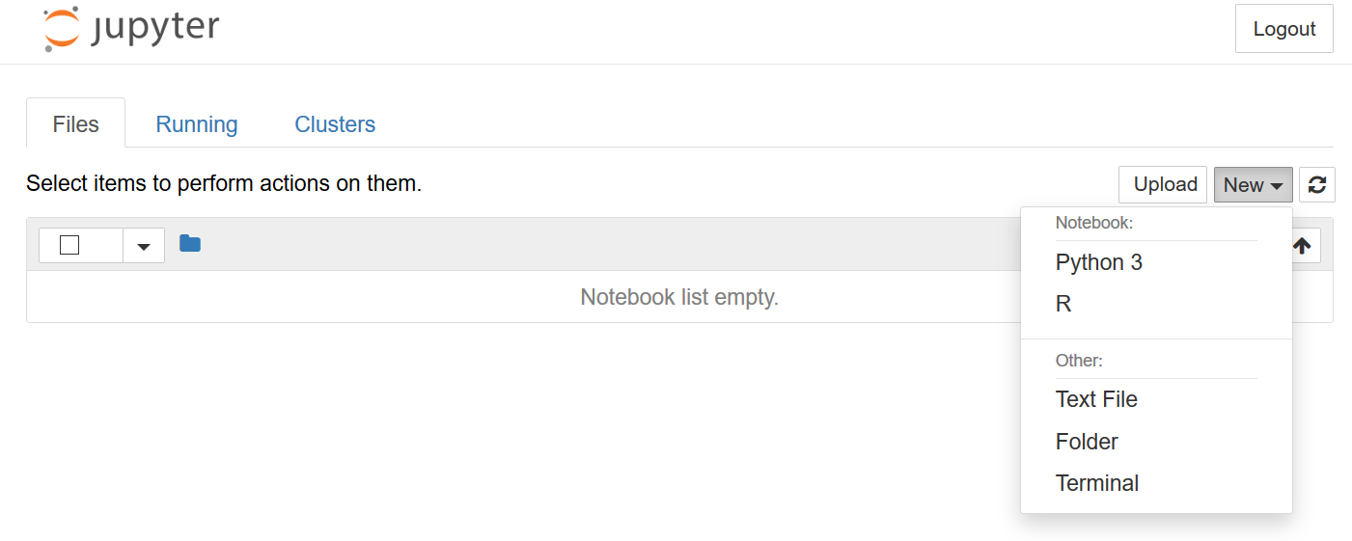
Getting Started - BioHPC
Login to Notebook
Kernels
(will come back to this)
Location: /home2/username/jupyter_notebooks/

Slide 11
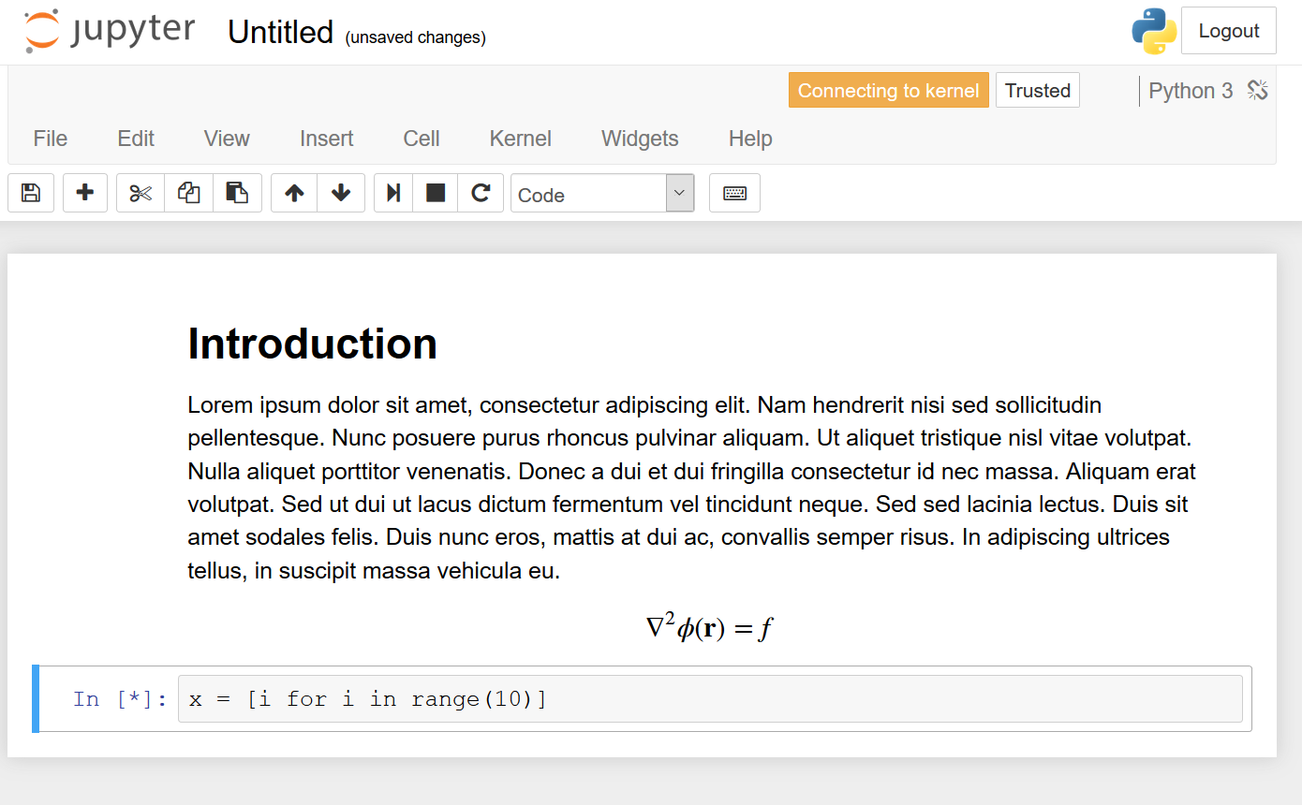
Usage
Cell 1
(markdown)
Cell 2
(code)

Slide 12
Usage
Evaluate
Markdown Cell
Formatted Text, Equation
Image, etc.
Evaluate
Evaluate expression, display
output, graphs, etc.
Code Cell

Slide 13
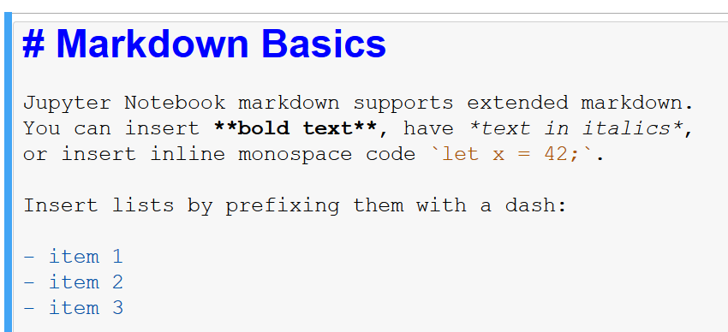
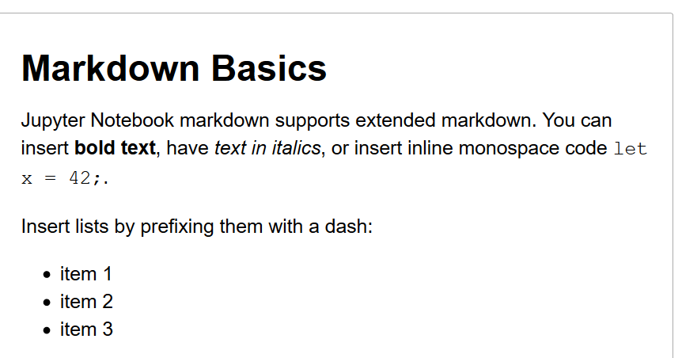
Usage - Markdown
Markup
Evaluate
Rendered

Slide 14
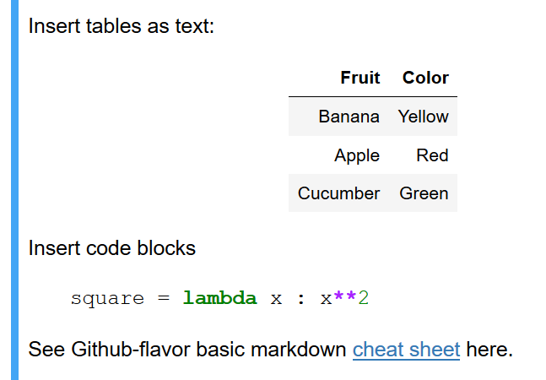
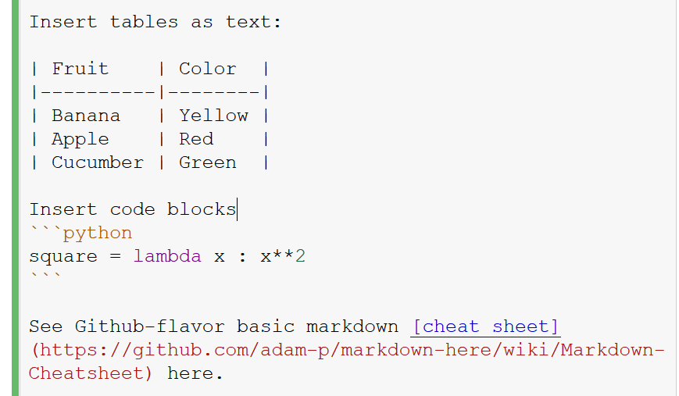
Usage - Markdown
Markup
Evaluate
Rendered

Slide 15
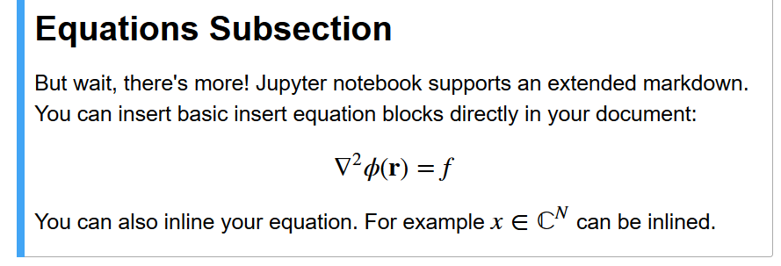
Usage - Markdown
Markup
Evaluate
Rendered

Slide 16
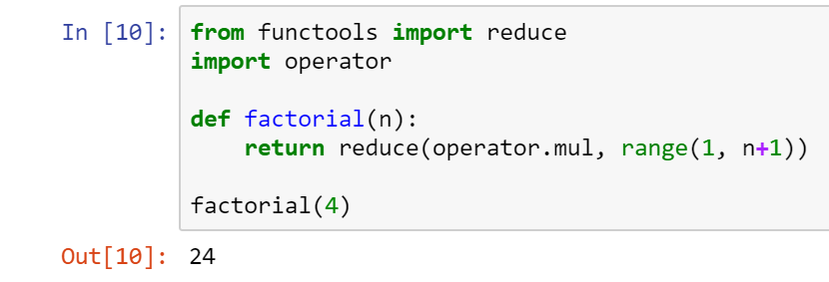
Code
Code Cell

Slide 17
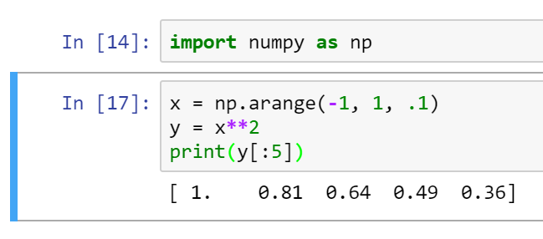
Code
Cell 1
Cell 2
'np' is also available in this cell
Execution Order
(Recall: interactive session)

Slide 18
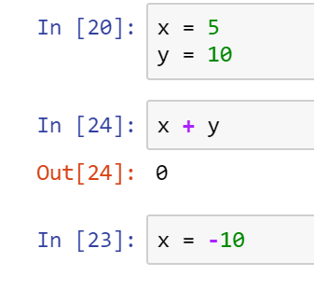
Code
Interactive session implications
????
Out of place execution order

Slide 19
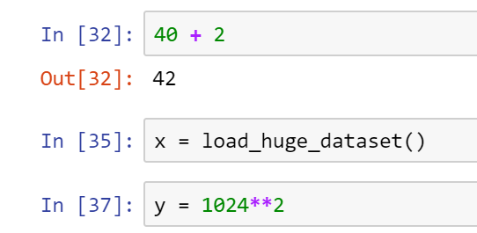
Code
Interactive session implications
data remains in session even after cell deletion

Slide 20
Extras
Extras
Notes:
Mark down, code and visualization. I’ll show you some extra functions in jupyter notebook

Slide 21
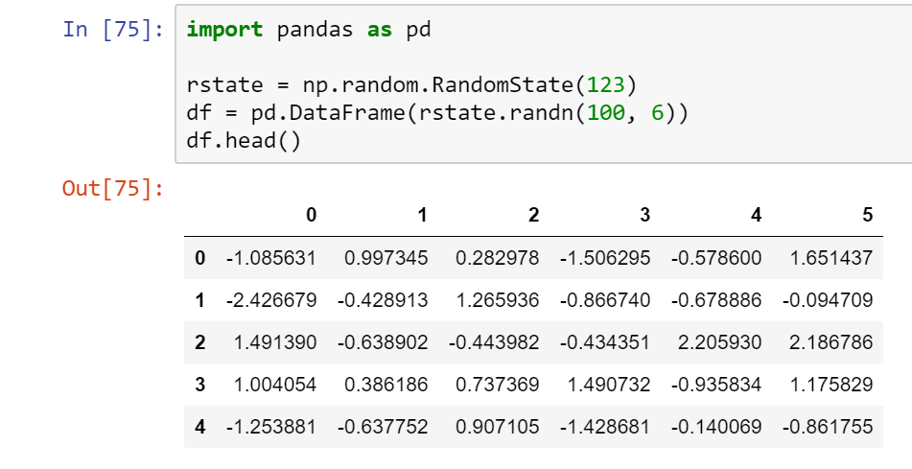
Extras
Dataframe default table rendering
Notes:
Numpy and pandas to do data cleaning or data processing, the dataframe has its default table format

Slide 22
Extras
Cell Command | Evaluation Result
object? | List documentation for 'object'
%lsmagic | List available extra functionality built into the kernel
%quickref | Quick reference on the kernel
Notes:
Learn more about the commands, you can do command?
% quick ref

Slide 23
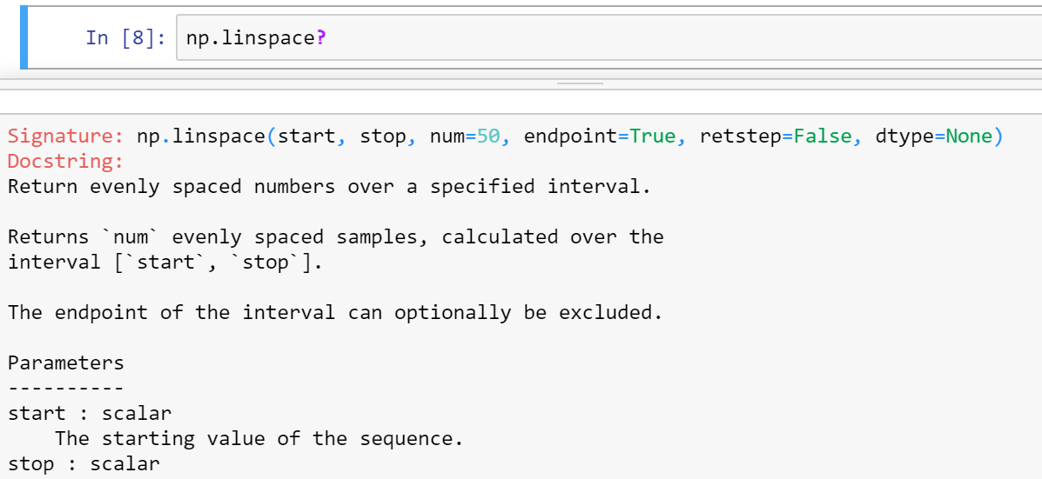
Extras

Slide 24
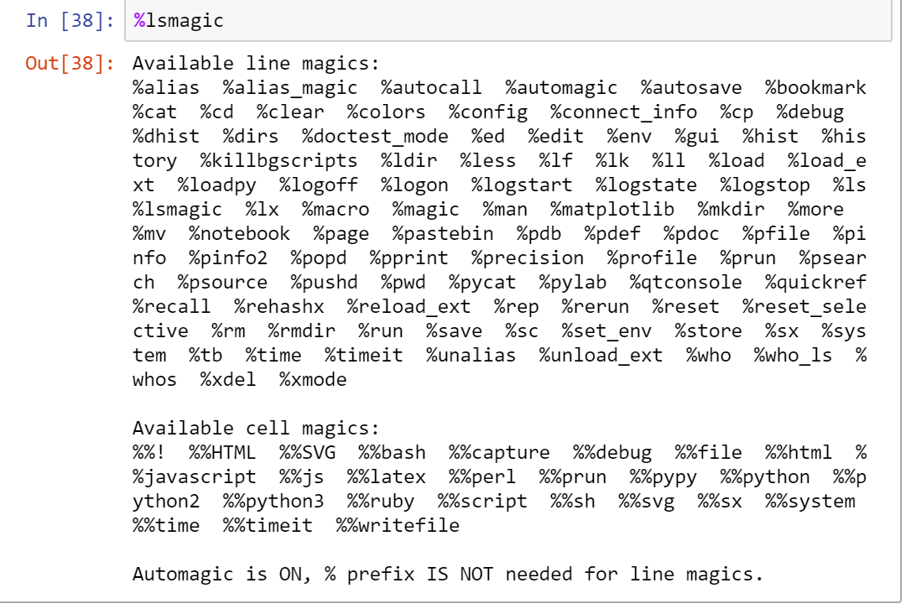
Code - Magics
Built-in to Kernel. Not platform dependent

Slide 25
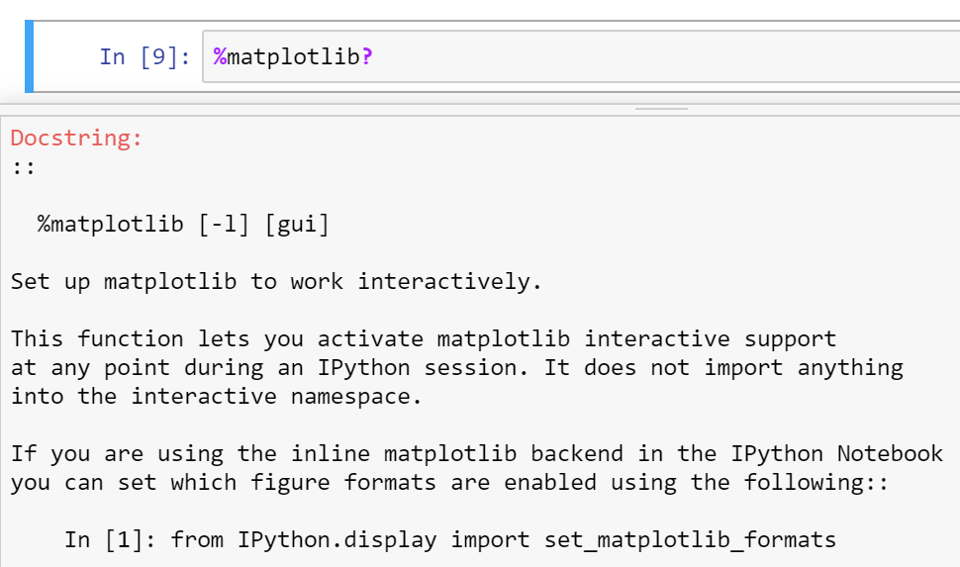
Code - Magics

Slide 26
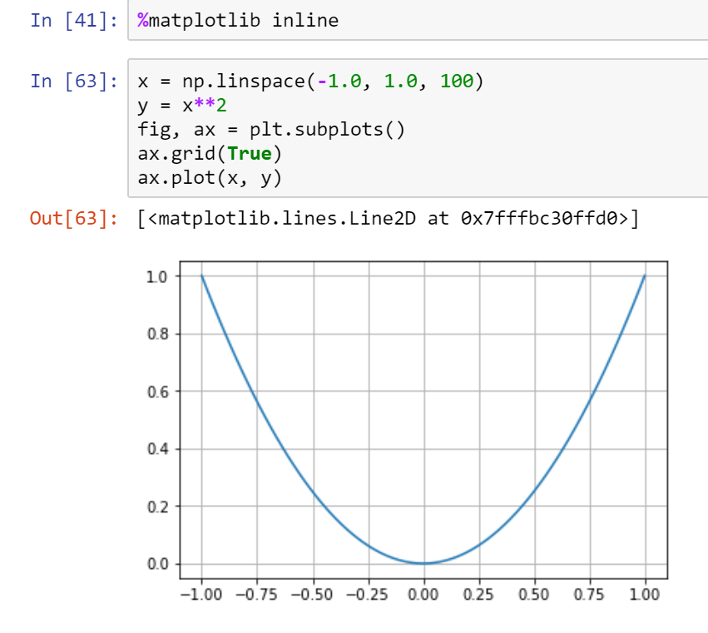
Code - Magics
Notes:
%matplotlib: any plt plot command will now cause a figure window to open, and further commands can be run to update the plot. Some changes will not draw automatically, to force an update, use plt.draw()
%matplotlib notebook: will lead to interactive plots embedded within the notebook, you can zoom and resize the figure
%matplotlib inline: only draw static images in the notebook

Slide 27
Getting Started - BioHPC
Kernels
Note: can modify environment directly from login node
Notes:
The next section, I’ll talk about different cases of the jupyter kernel/software environment.
A kernel is a “computational engine” that executes the code contained in a Notebook document. The jupyter kernels can execute different languages, like R, python, matlab. And I’ll show you how to build all three kernels in the following slides.

Slide 28
Getting Started - BioHPC
Recipe 1 – Create a new isolated python3 kernel using Conda on BioHPC
$ ssh yourusername@nucleus.biohpc.swmed.edu
$ module load python/3.7.x-anaconda
$ conda create --name foo python=3
$ conda activate foo
(foo) $ pip install ipykernel
(foo) $ pip install <additional modules as needed>
(foo) $ python -m ipykernel install --user --name foo --display-name "my foo env“
(foo) $ conda deactivate
# Look under /home2/<yourusername>/.conda/envs
1) create conda env
install packages
create jupyter kernel
exit conda env

Slide 29
Getting Started - BioHPC
Recipe 2 – Create a new isolated R kernel using Conda on BioHPC
$ ssh yourusername@nucleus.biohpc.swmed.edu
$ module load python/3.7.x-anaconda
$ conda create --name my_renv r r-essentials r-base
$ conda activate my_renv
(my_renv) $ R
> IRkernel::installspec(name="my_renv", displayname=“my R demo") # Displayname shows in jupyter notebook
> q()
(my_renv) $ conda deactivate
# Look under /home2/<yourusername>/.conda/envs
1) create conda env
install packages
create jupyter kernel
exit conda env

Slide 30
Getting Started - BioHPC
Recipe 3 – Create a new MATLAB kernel using Conda on BioHPC
$ ssh yourusername@nucleus.biohpc.swmed.edu
$ module load python/3.7.x-anaconda
$ conda create --name my_matlab_env python=3.6
$ conda activate my_matlab_env
(my_matlab_env) $ cd /home1/apps/MATLAB/R2020a/extern/engines/python
(my_matlab_env) $ python3 setup.py build --build-base=/home2/yourusername/tmp install \ --prefix=/home2/yourusername/.conda/envs/my_matlab_env/
(my_matlab_env) $ pip install matlab_kernel
(my_matlab_env) $ python -m matlab_kernel install --user --name "my_matlab_demo"
(my_matlab_env) $ conda deactivate
# currently MATLAB only supports 2.7, 3.5, 3.6
1) create conda env
install packages
create jupyter kernel
exit conda env

Slide 31
Getting Started - BioHPC
Kernels
Note: can modify environment directly from login node

Slide 32
Getting Started - BioHPC
Recipe 4 – Create a new conda environment on different partition
(One conda env can easily use several GB. /home2 Have only 50 GB storage under ~/)
$ ssh yourusername@nucleus.biohpc.swmed.edu
$ module load python/3.7.x-anaconda
$ mkdir /project/yourdepartment/yourusername/conda_envs
$ conda create --prefix /project/yourdepartment/youruser/conda_envs/your_env_name
$ conda activate /project/yourdepartment/youruser/conda_envs/your_env_name
(long/path/your_env_name) $ <install additional modules as needed>
(long/path/your_env_name) $ conda deactivate
# ‘conda_env’ is arbitrary name
# must reference by path

Slide 33
Getting Started - BioHPC
Recipe 5 – View and Modify Jupyter kernels
$ module load python/3.7.x-anaconda
$ jupyter kernelspec list
my_env foo
my_matlab_demo
$ jupyter kernelspec uninstall my_env
# Removes kernel, not environment
Notes:
Ipython is replaced with jupyter kernelspec list

Slide 34
Getting Started - BioHPC
Recipe 6 – Remove Conda environment
$ module load python/3.7.x-anaconda
$ conda env list
my_env foo
my_matlab_demo
$ conda env remove --name my_env
# Look under ~/.conda/envs

Slide 35
Getting Started - BioHPC
Recipe 6.1 – Clean Conda unused packages and caches
$ module load python/3.7.x-anaconda
$ conda clean --all --dry-run # Dry run will NOT delete anything
Will remove the following tarballs:
/home2/<your username>/.conda/pkgs
pandocfilters-1.4.2-py_1.tar.bz2 9 KB
r-broom-0.7.6-r40hc72bb7e_0.tar.bz2 1.7 MB
fonts-conda-forge-1-0.tar.bz2 4 KB
# if satisfied with the operation to be performed
$ conda clean –all # This command will DELETE those packages

Slide 36
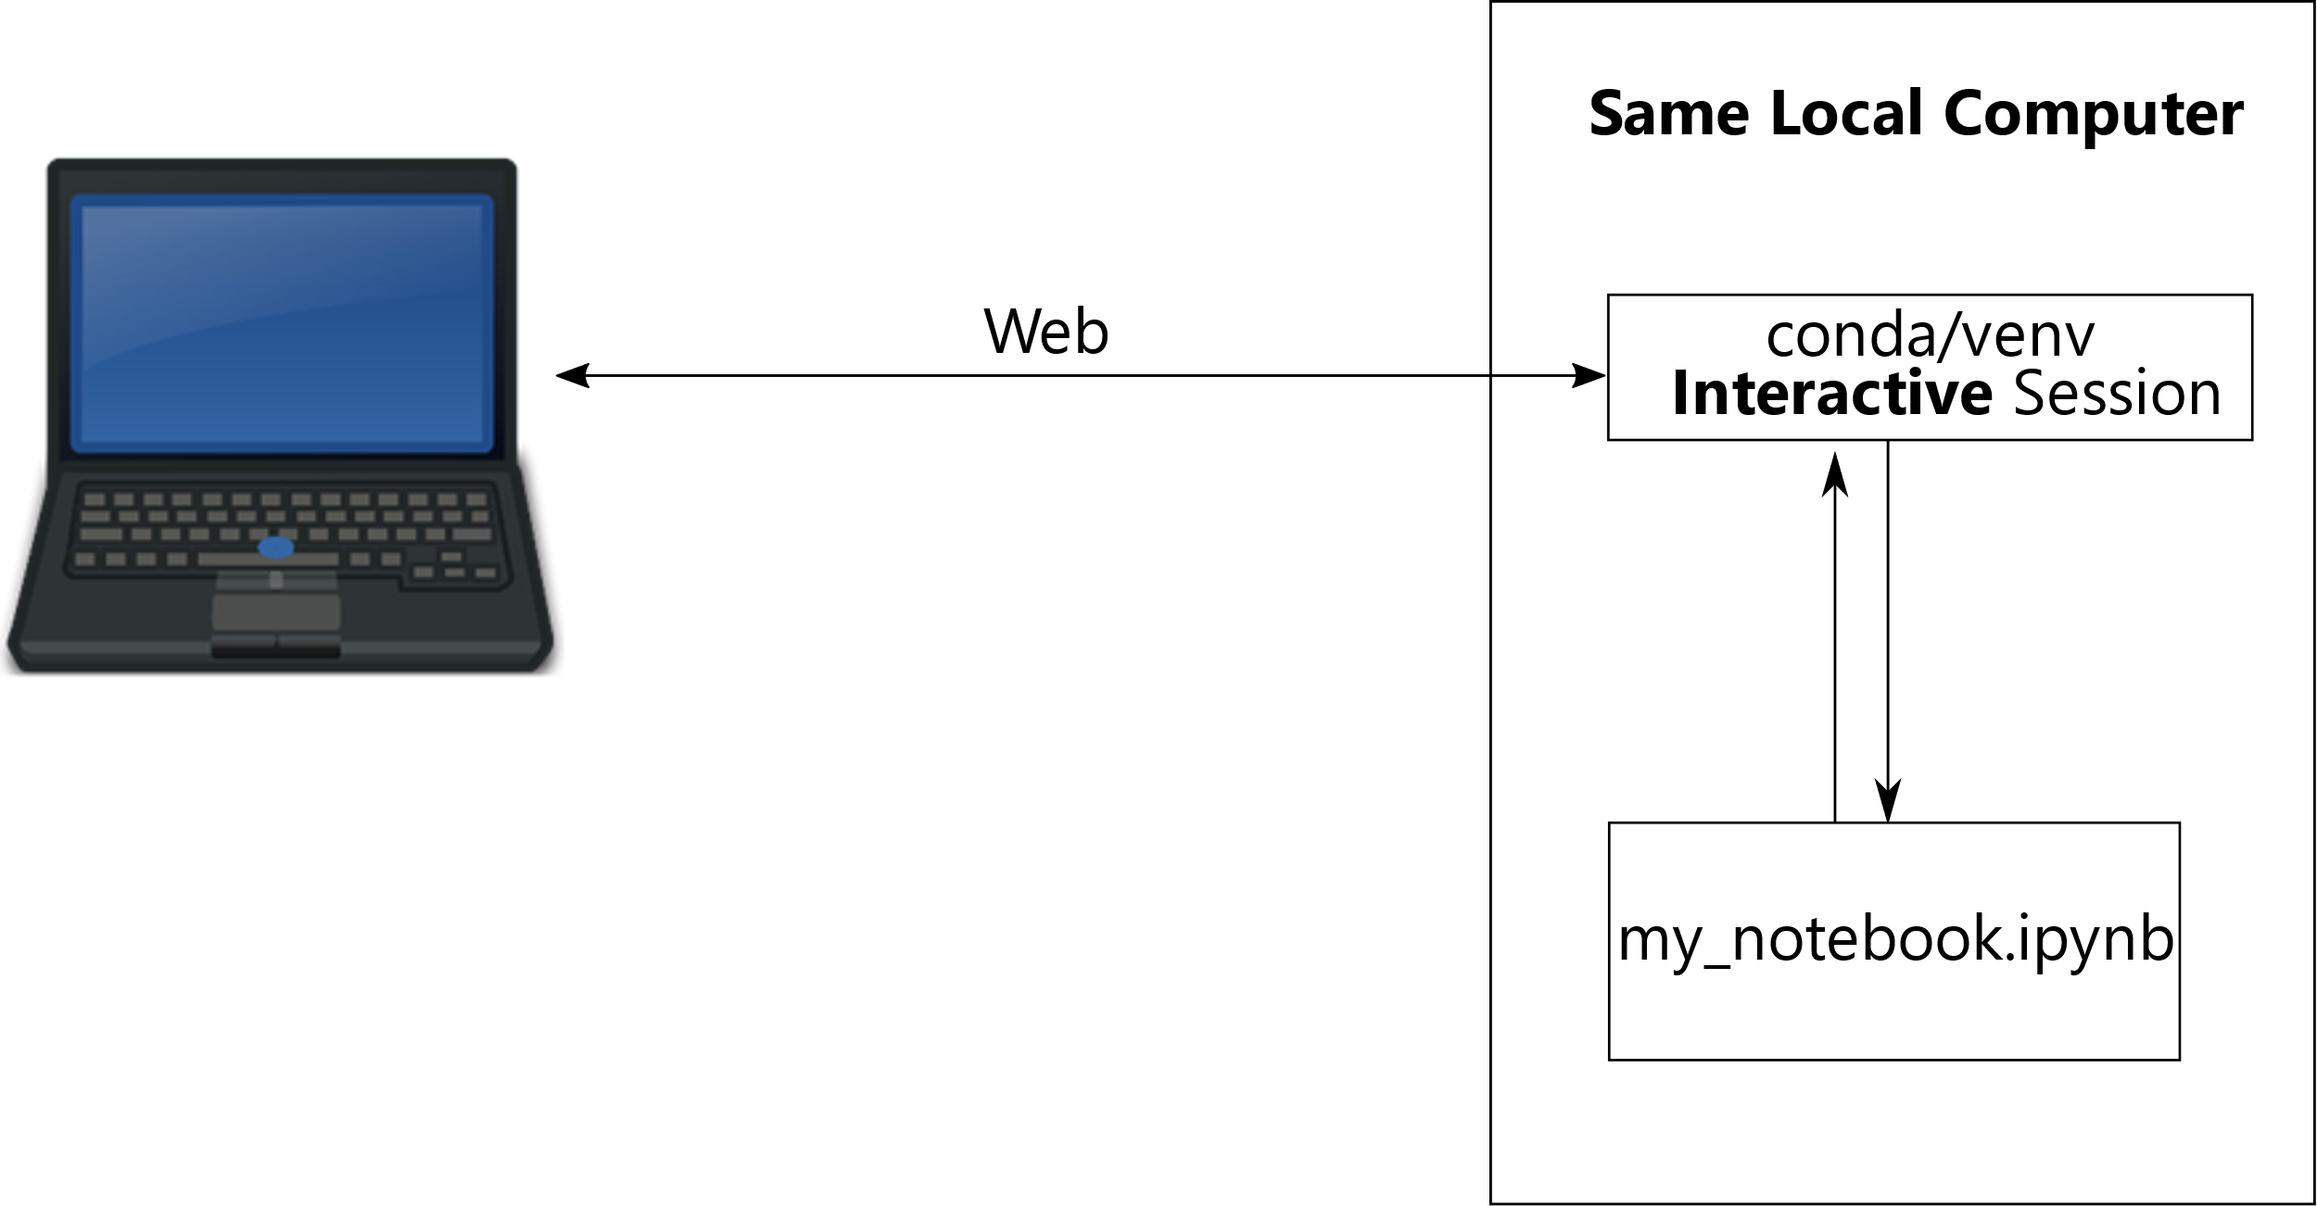
Mental Model - Local
Side note: can run locally on your own computer

Slide 37
Getting Started - Local
Recipe 7 – Install Jupyter Notebook locally using venv
$ mkdir myproject && cd myproject
$ python -m venv foo
$ ./foo/bin/activate
(foo) $ pip install jupyter
(foo) $ <install additional modules>
(foo) $ jupyter notebook
# Uses default python interpreter; assumes python3
# Start Jupyter Notebook webserver

Slide 38
Suggestions
Where applicable:
Consider not linking to contents on the internet
Consider using a fixed seed for 'random' number generation
Seriously consider using different environments for different projects (py)
Always store and distribute your Notebooks (and projects) with dependency specifications.

Slide 39
Example Workflow
Recipe 8: Distribute Conda-based project
(Assumes that you have already followed Recipe 1 or Recipe 3)
Let’s say your research is contained in the betsy_research environment
a) You can export conda env to environment.yml
$ ssh yourusername@nucleus.biohpc.swmed.edu
$ module load python/3.7.x-anaconda
$ conda activate betsy_research
(betsy_research) $ conda env export --file environment.yml
b) If applicable, you can also create venv export of environment
(betsy_research) $ pip freeze > requirements.txt
Share your project files along with environment.yml and/or requirements.txt
Notes:
pip freeze is a command that allows you to see what modules you have installed with the pip install command to this point

Slide 40
Example Workflow
Recipe 9: Work on BioHPC, on a project shared with you.
Restore environment based on yml
Let’s say betsy_research was shared with you:
- research_docs.ipynb
- environment.yml
- other assets
$ ssh yourusername@nucleus.biohpc.swmed.edu
$ module load python/3.7.x-anaconda
$ cd path_to_environment.yml
# change env name (line1 of environment.yml) to created_env_name if needed
$ conda env create -f environment.yml
$ conda activate created_env_name
(created_env_name) $ python -m ipykernel install --user --name created_env_name --display-name “some display name"
Notes:
conda create --file environment.yml

Slide 41
Example Workflow
Recipe 10: Load venv-compatible project locally using virtual-environment
Restore environment based on requirements.txt
Let’s say betsy_research was shared with you that has requirements.txt:
- research_docs.ipynb
- requirements.txt
- other assets
$ cd path_to_betsy_research_directory
$ python3 -m venv betsy_env
$ ./betsy_venv/bin/activate
(betsy_venv) $ pip install -r requirements.txt
(betsy_venv) $ jupyter notebook

Slide 42
iPython – Examples
See distributed
examples on portal
Usage: (Open on BioHPC)
$ ssh yourusername@nucleus.biohpc.swmed.edu
$ cd path/to/demo/file
$ module load python/3.7.x-anaconda
$ conda create --name biohpc_demo
$ conda activate biohpc_demo
(biohpc_demo) $ pip install --requirement requirements.txt
(biohoc_demo) $ python -m ipykernel install --user --name biohpc_demo --display-name=“BioHPC_Demo”
(biohpc_demo) $ conda deactivate
Notes:
--r replace with --requirement

Slide 43
iPython – Examples
See distributed
example on portal
Usage (Your own machine):
$ cd path/to/demo/files
$ python3 -m venv biohpc_demo # This will create biohpc_demo folder in the current directory
$ chmod +x biohpc_demo_env/bin/activate # add execution permission to file activate
$ source biohpc_demo_env/bin/activate
(biohpc_demo) $ pip install -r requirements.txt
(biohpc_demo) $ jupyter notebook

Slide 44
References
References
Jupyter Notebook Documentation
https://jupyter.org/documentation
Conda getting started
https://docs.conda.io/projects/conda/en/latest/user-guide/getting-started.html
Markdown
Github Markdown cheat sheet
https://github.com/adam-p/markdown-here/wiki/Markdown-Cheatsheet
Interactive Markdown
https://www.markdowntutorial.com/
Markdown Pad
http://www.markdownpad.com/

